Slide 1
Fanny and Zoie

Slide 2
Brainpop is an educational website that can be used on devices such as the laptop, iPad, iPhone and Android devices. This app provides over 1,000 videos that can be used by teachers and students from K-12.

Slide 3
What does it do?
It provides educational videos regarding the subjects
Maths, English, Science, Social Science, Economics, Engineering, Health, Technology, Arts and Music.
Not only does Brainpop provide videos, but also quizzes and games

Slide 4
Disadvantages
Not free for all
Too many apps (better to widen option, not apps)
Requires wifi
Only laptop can play games
Limited access, requires subscription

Slide 5
Advantages
Brent has a subscription for Brainpop.
Username: brentmanila
Password: learning
Free movies
Games
Quizzes
Range of subjects
Kid friendly
Movie of the Day
In French
In Spanish
Free with in-app purchases
ESL
Jr.
Many devices
easy to catch up (international students)
academic bowl
introduction to topics - visual learners

Slide 6
Why is Brainpop worth it?
-It provides many different videos
-They are very educational
-It is very useful for visual learners
-Students would most likely pay more attention
-Their videos are good ways of introducing a topic.

Slide 7
Features demonstration time!

Slide 8
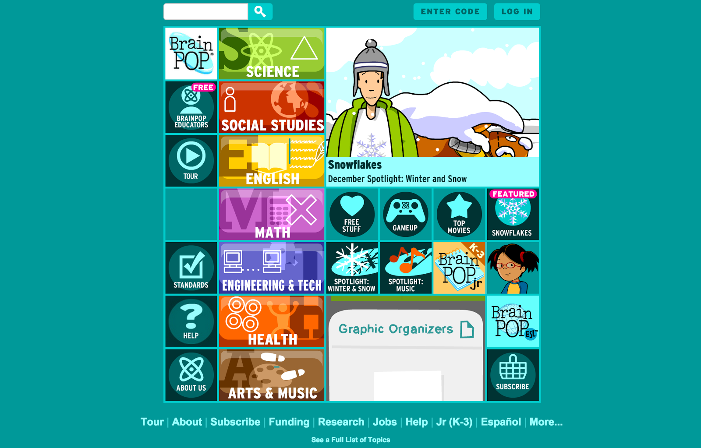

Slide 9
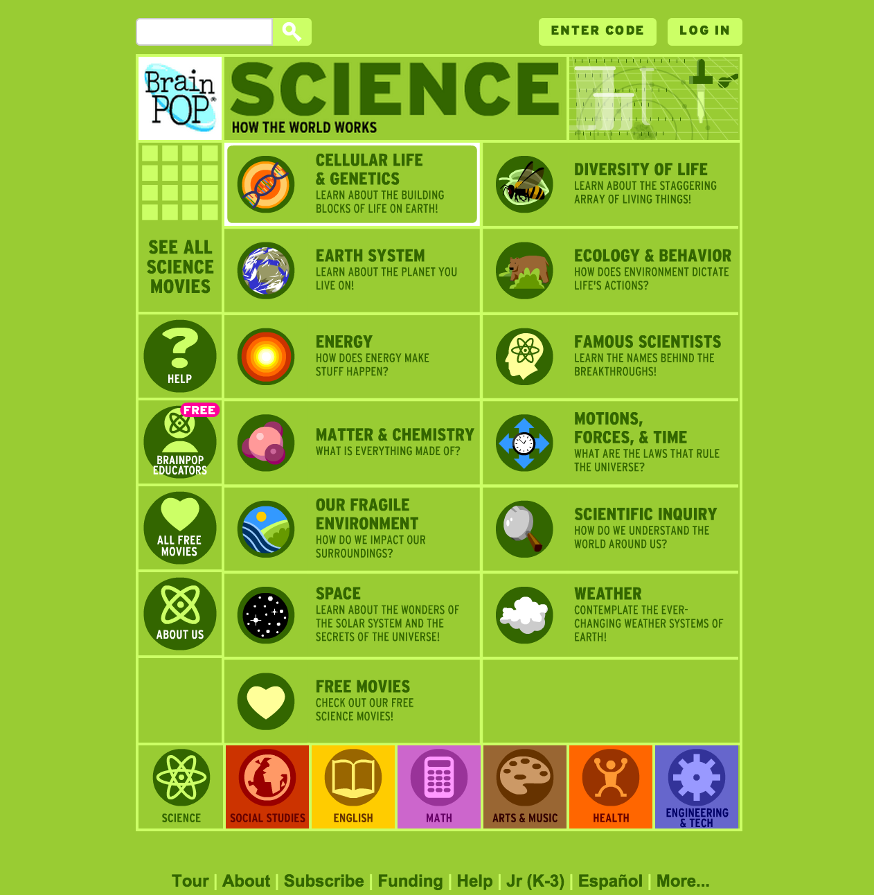

Slide 10
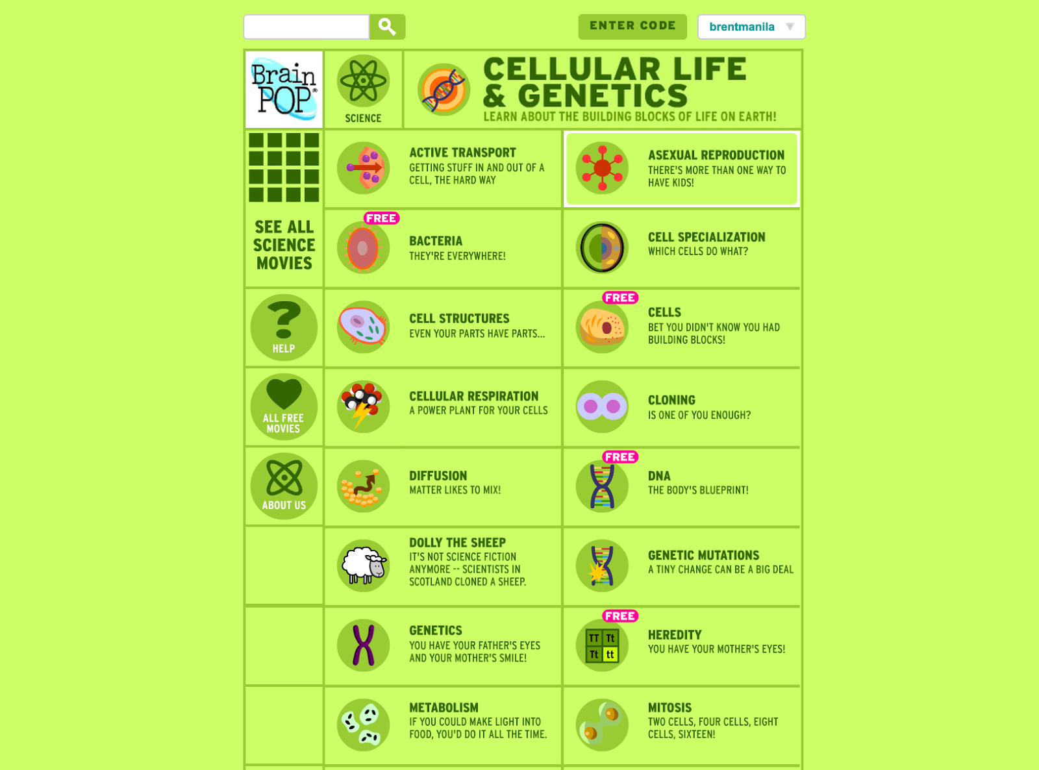

Slide 11
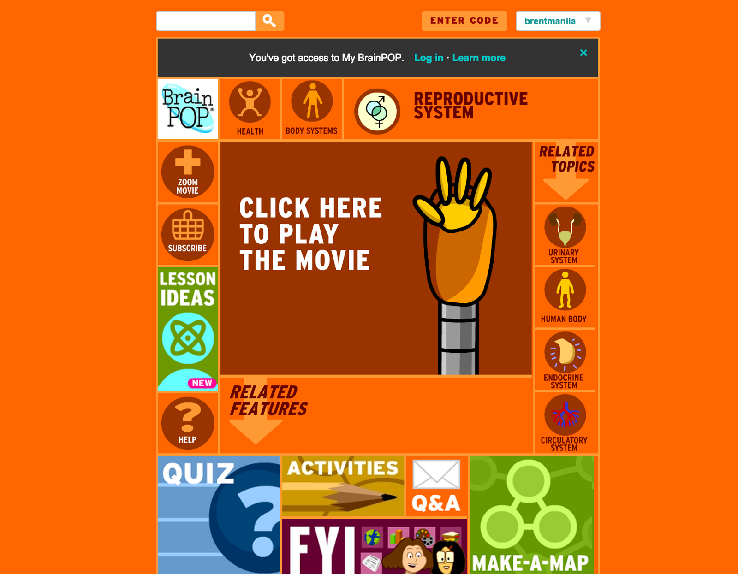

Slide 12
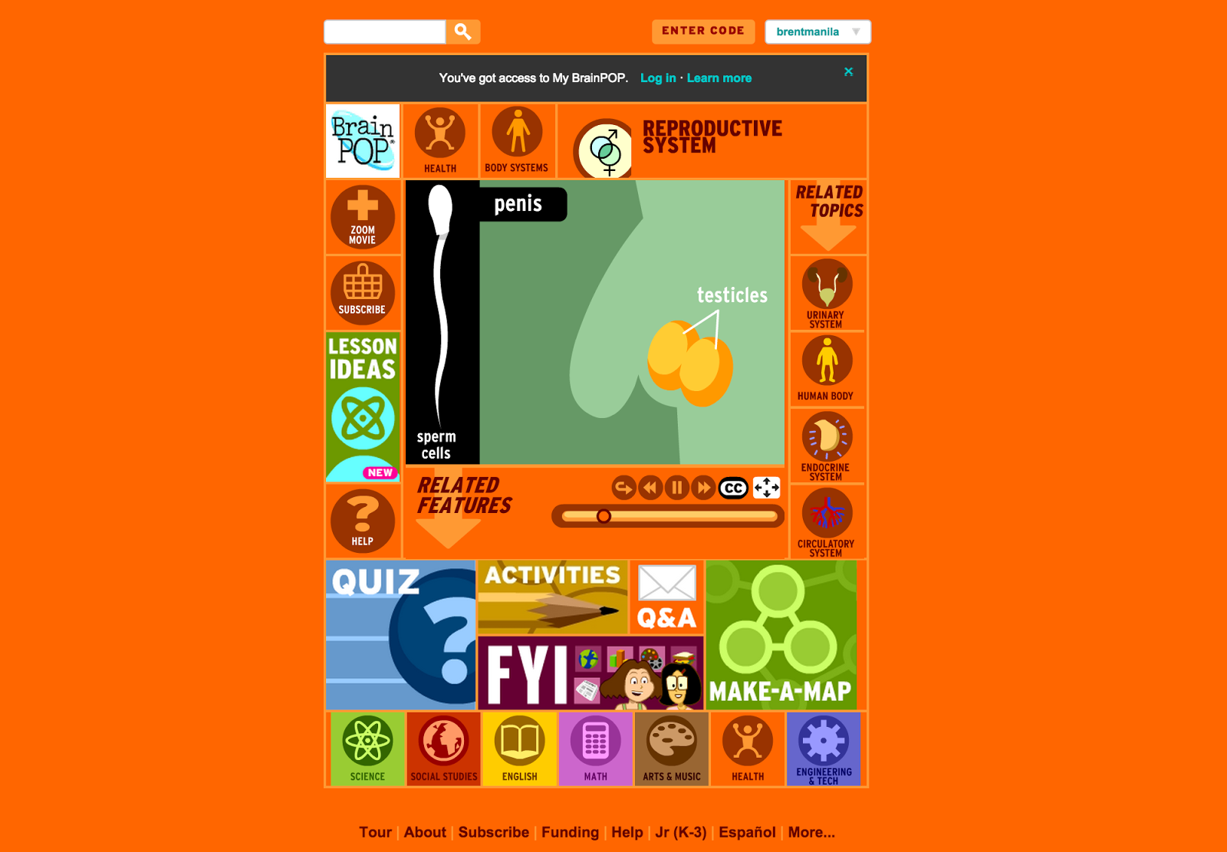

Slide 13
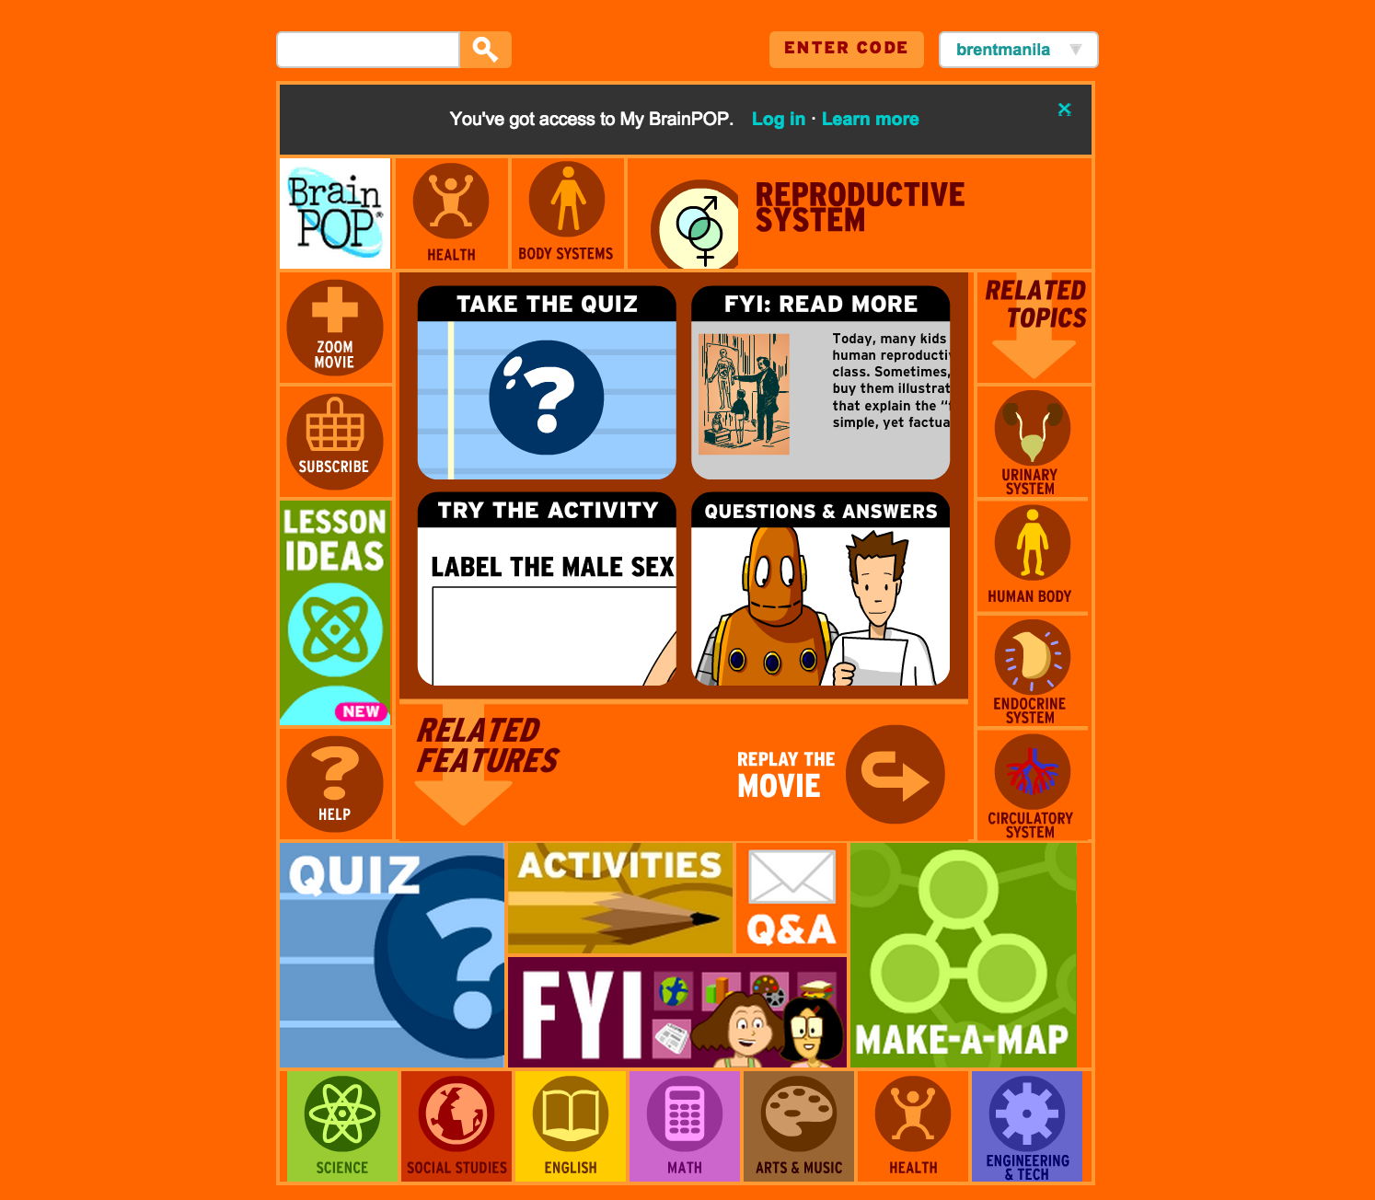

Slide 14
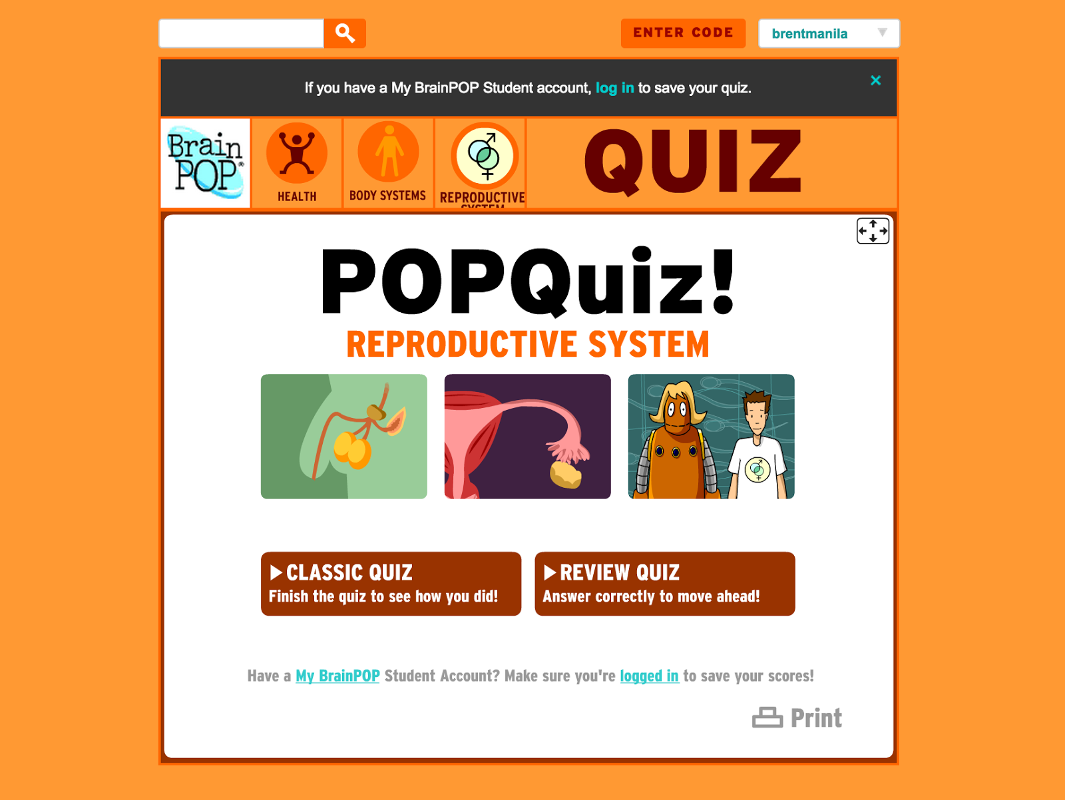

Slide 15
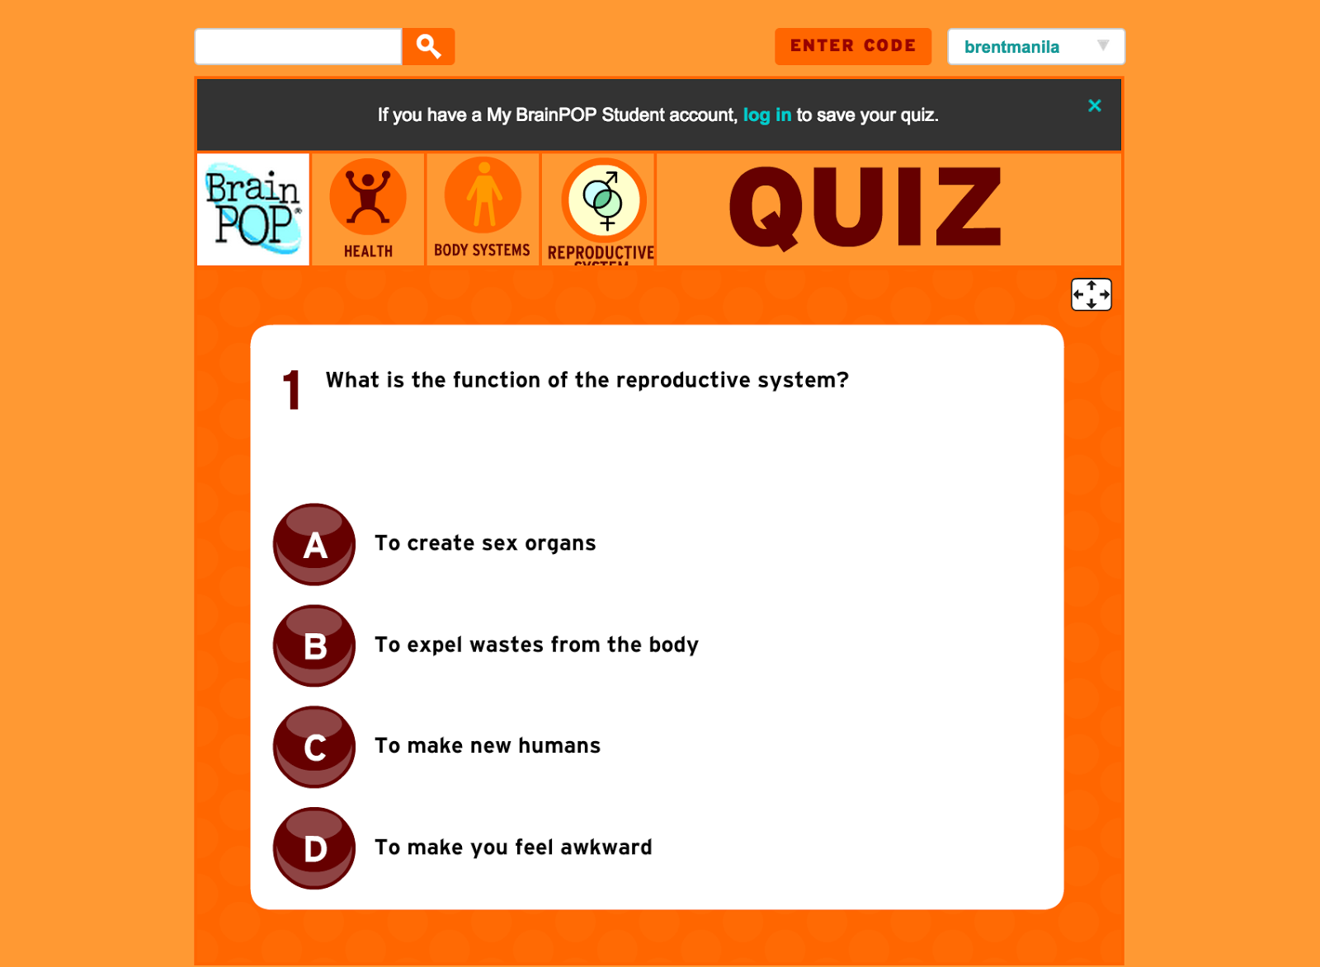

Slide 16
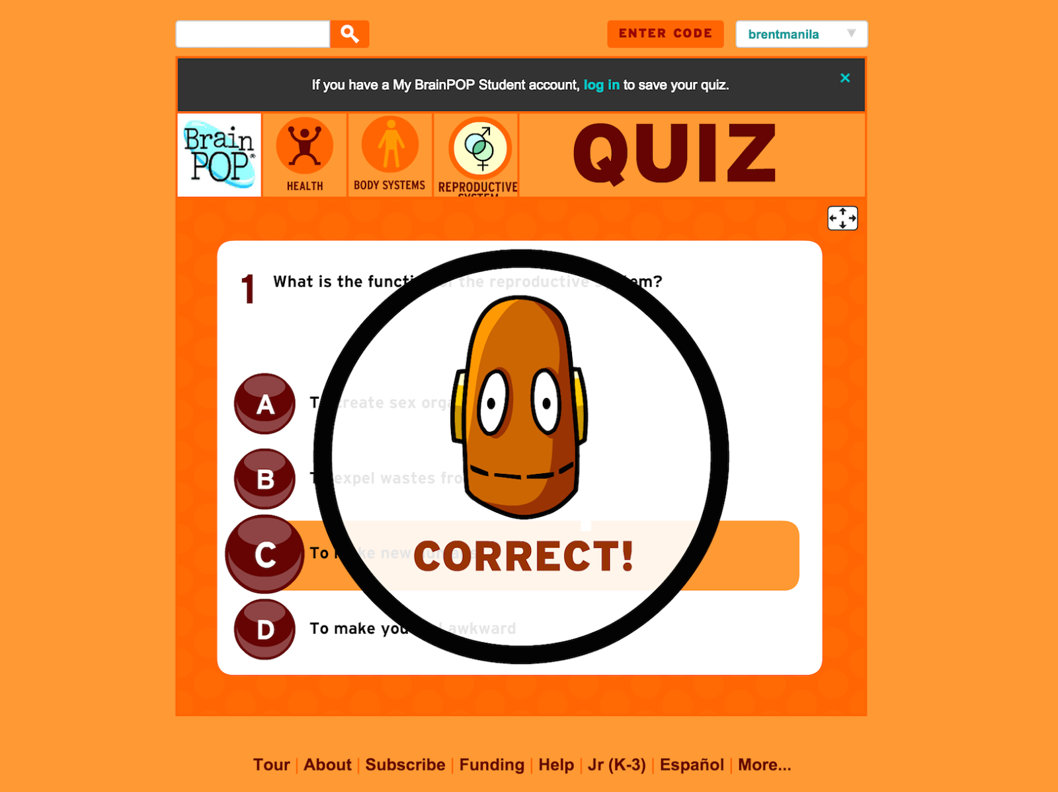

Slide 17
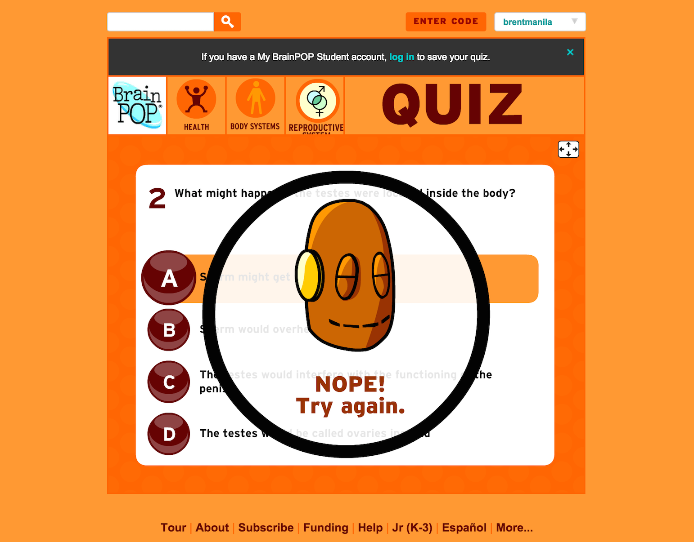

Slide 18
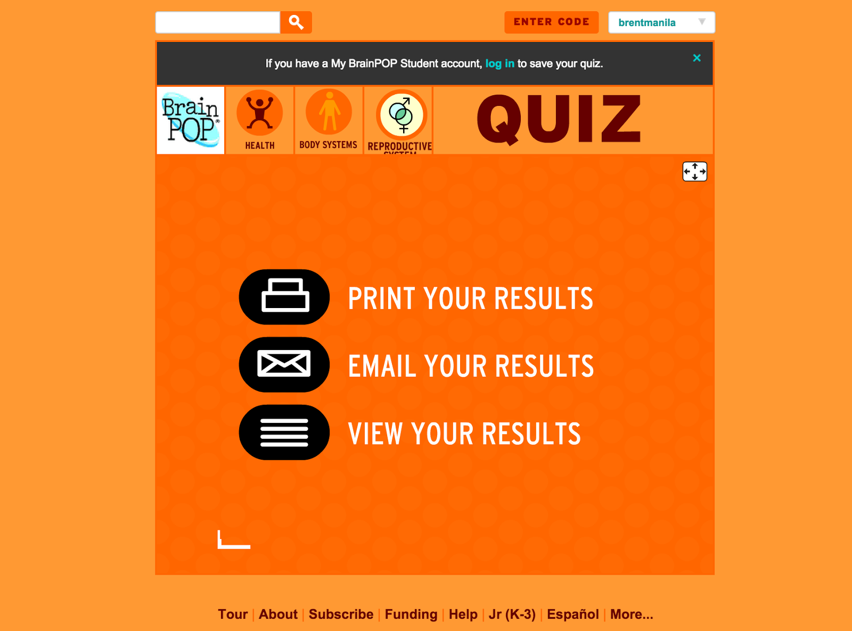

Slide 19
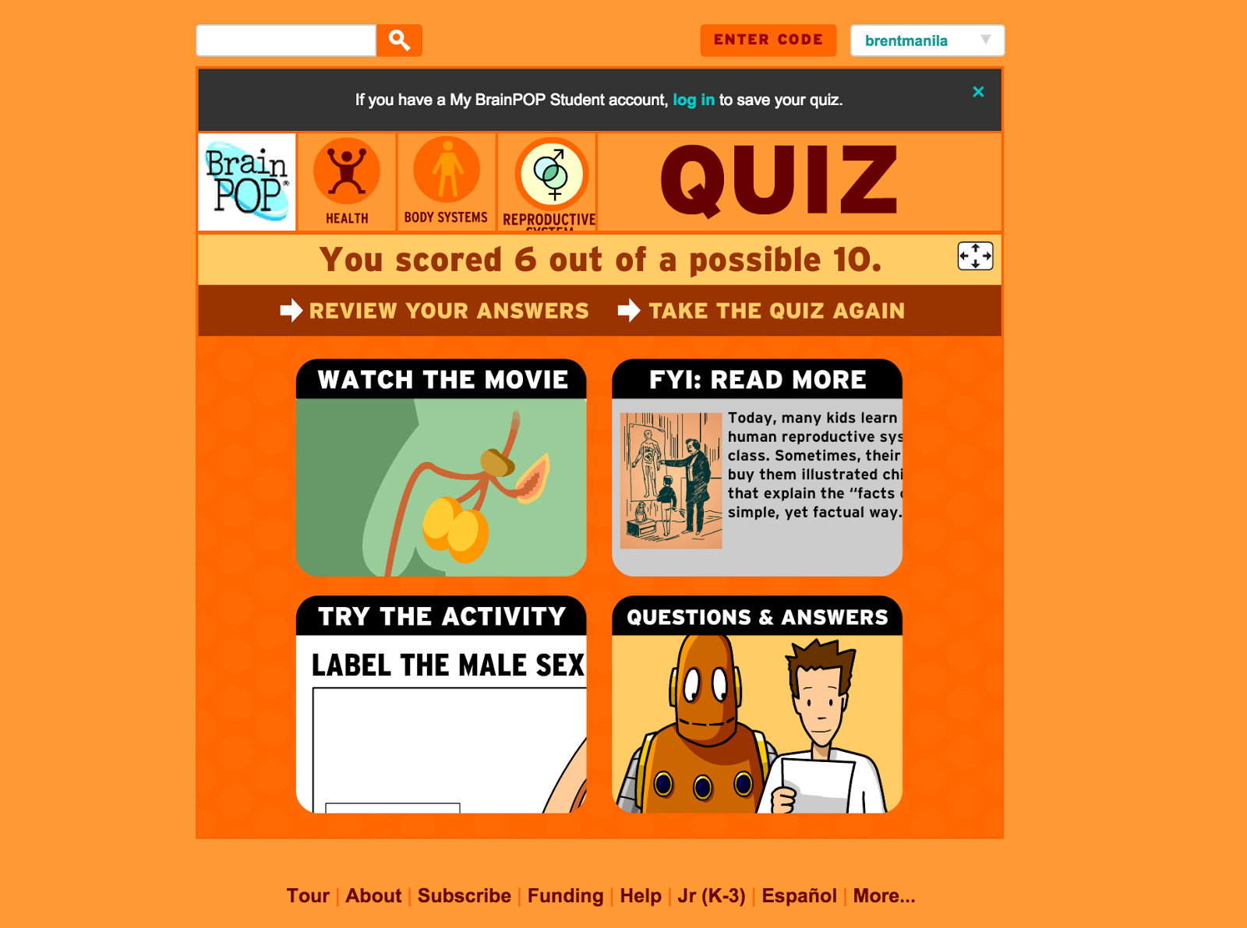

Slide 20
